Slide 1
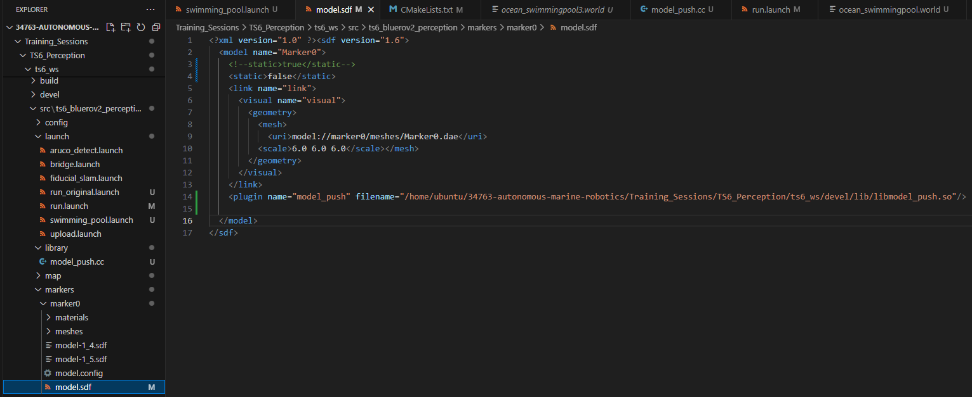
In order to make the qr code move a library has to be inserted
Maybe you have to update the filename structure

Slide 2
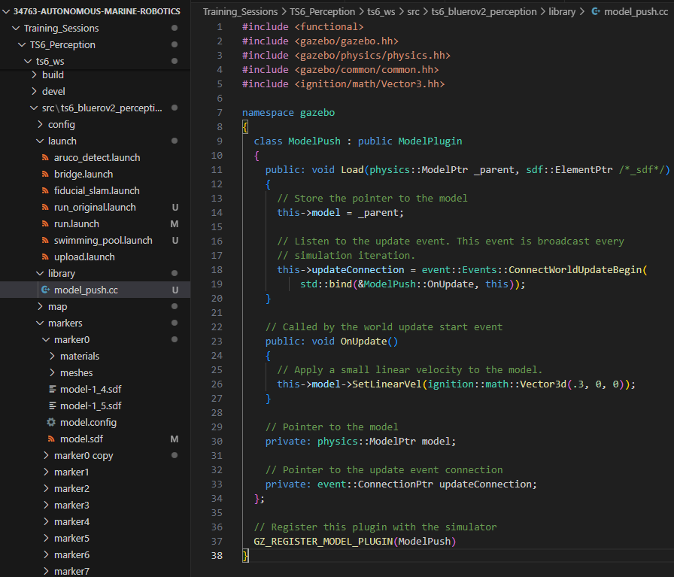
The new library is inserted…
Right now it is moving 0.3 meter per second. If you want to change it do it here.
Every time the 0.3 is changed you have to run catkin_make again

Slide 3
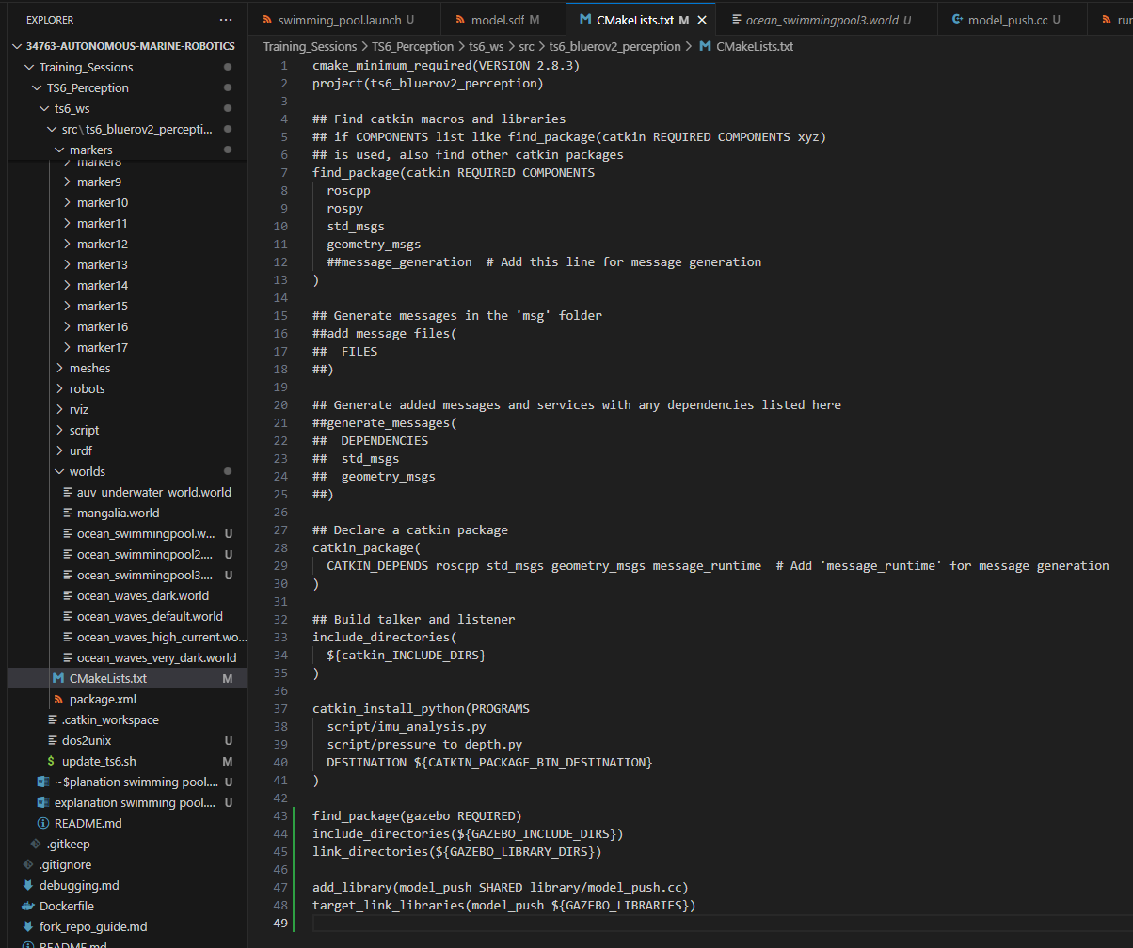
… and added to the Cmakelist.txt file

Slide 4
Following,
Cd C:\Users\chy\34763-autonomous-marine-robotics\Training_Sessions\TS6_Perception\ts6_ws\update_ts6.sh
Catkin_make
Source devel/setup.bash

Slide 5
Setup for world
Ocean_swimmingpool3.world is the updated world
This world was used in swimming_pool.launch
Run.launch is launching swimming_pool.launch instead of the bridge.launch

Slide 6
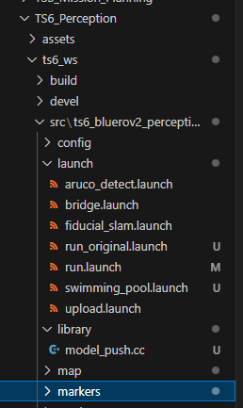
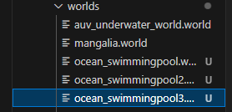
New created files

Slide 7
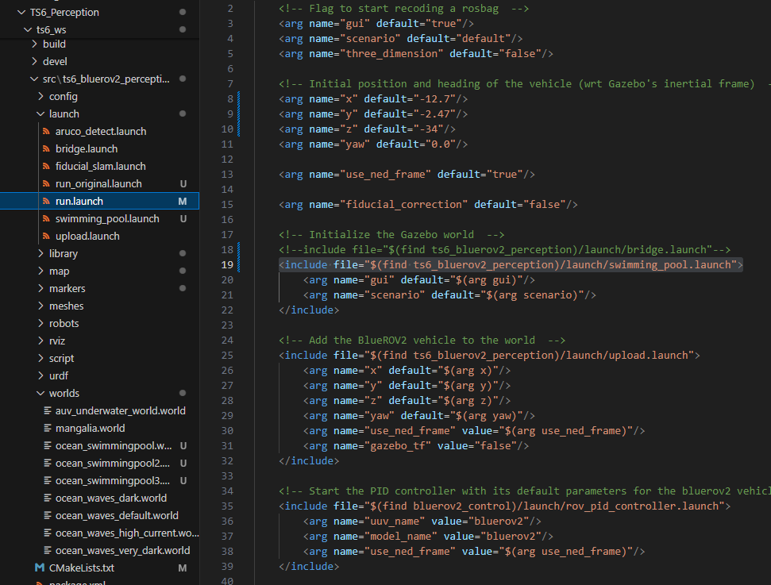
Updated
files

Slide 8
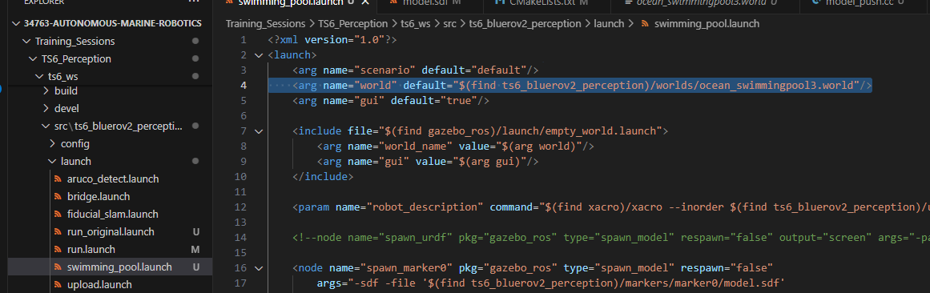
Updated file

